Slide 1
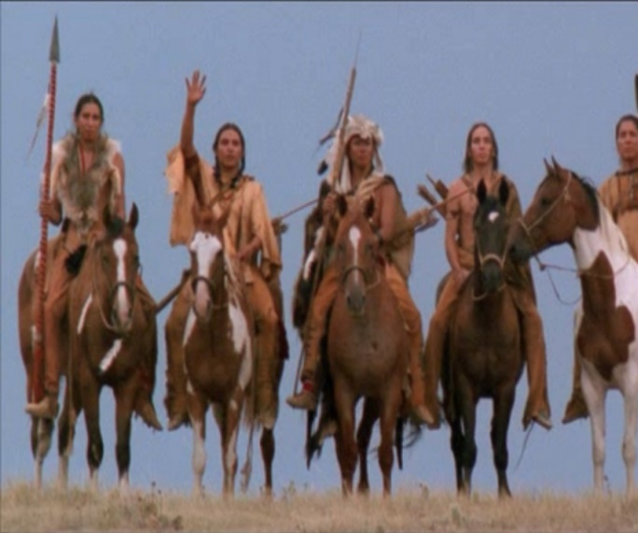
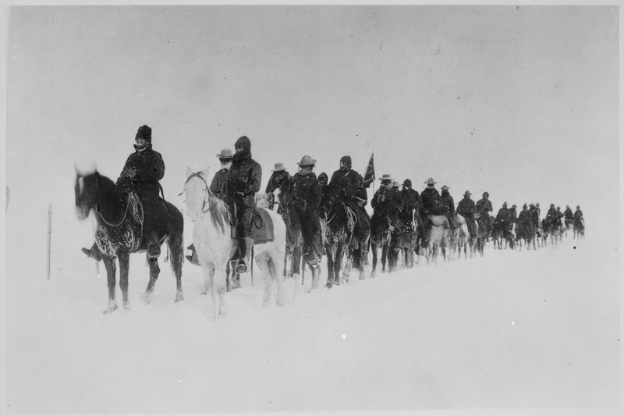
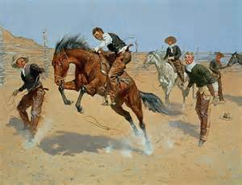
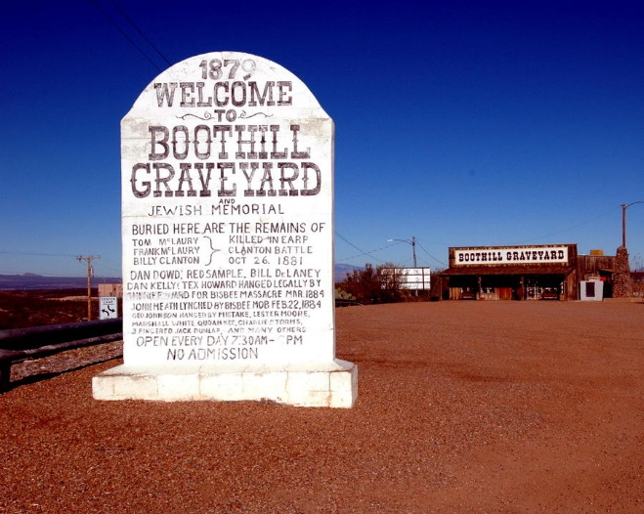
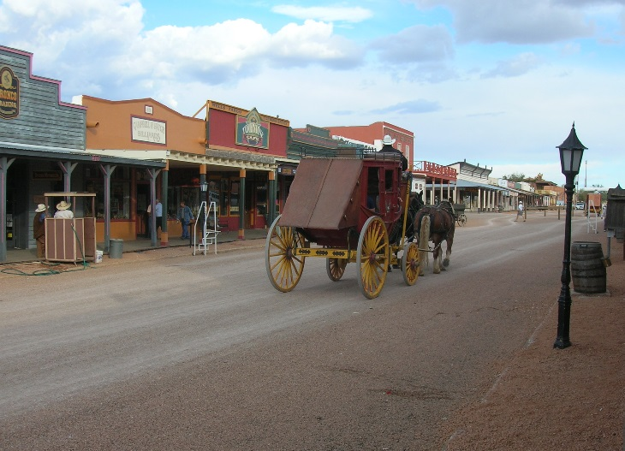
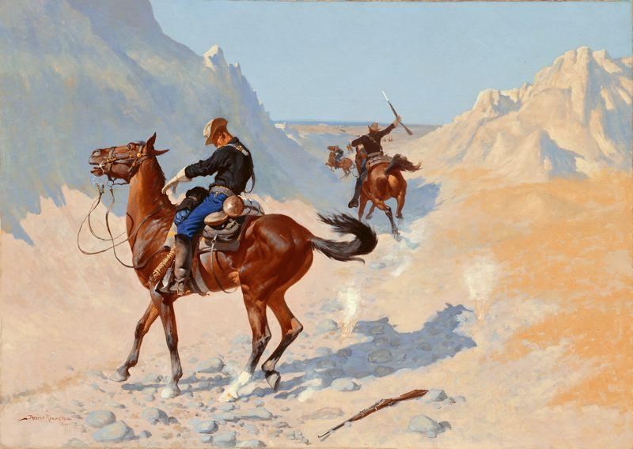
FILM- The American West
The changing view of America, the rise of the Anti Hero and ethnic stereotypes
The Searchers, Dances with Wolves, Tombstone, Bury my Heart at Wounded Knee

Slide 2
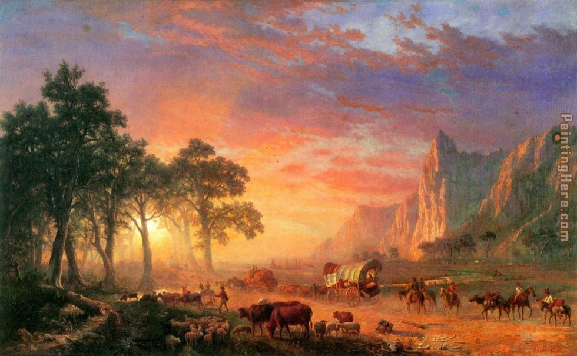


Slide 3
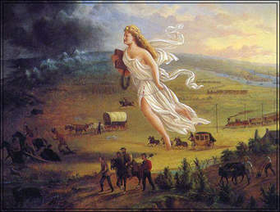
Why are Americans moving West?
Manifest Destiny
California Gold Rush
Mormon Resettlement in Utah
Homestead Act (1862)
Pacific Railway Act
Exodusters from the South
Transcontinental Railroad

Slide 4
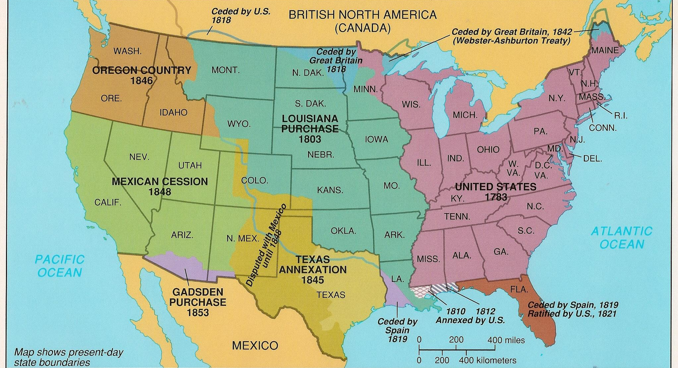

Slide 5
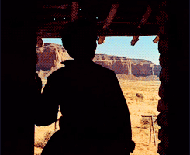
Western genre films
Western films were often based on existing stories and plays.
  Nineteenth century American fiction aka the Dime Novel
The earliest Westerns are more stylized because they also portrayed the conflict between good and evil.
  good, after many hardships, normally triumphs over evil and in a neat or clever way.
  Similar to morality stories common to many religions.
As the new societies of America were established they wanted a good moral code and role models.

Slide 6
Characteristics of the Western
action in the form of gun-fighting, horse chases, fistfights
landscape provides a backdrop of grandeur, harshness, sublime beauty
Often trains or wagons are present as these are the civilizing forces of progress

Slide 7
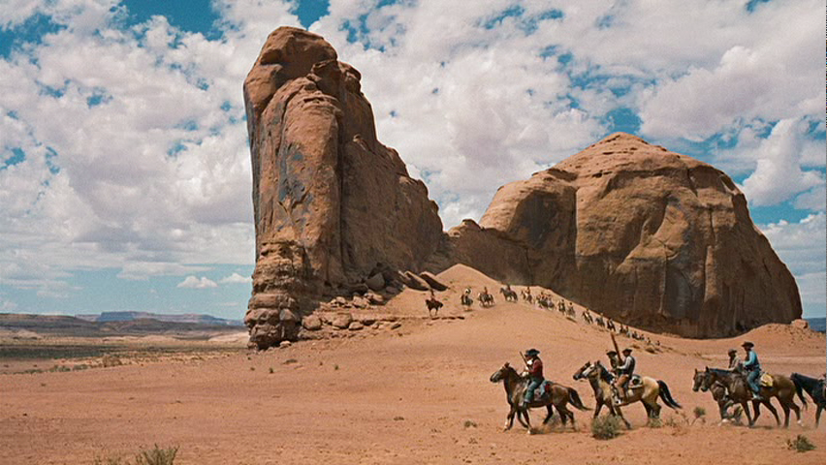
Common themes of Westerns
Man against nature, especially a hostile environment.
Man against hostile natives.
Good versus evil against the background of unspoilt nature.
Crimes and chases in a nineteenth century American setting.
ordinary person overcoming wrong or oppression and triumphing in the end

Slide 8
More Characteristics….
The Civil War often plays an important role in many Westerns…
A backdrop of violence
Heroes who have been impacted by the violence of this war
The fierce independent spirit

Slide 9
Mirrors the development of the west…
    a man of violence with a shadowy past who is making the transition from civilization (the east) to wildness (the west) and back to civilization (subduing the west)
    He fights for order and justice but seeks to live unfettered and free….a paradox!

Slide 10
The Western Hero
solitary, self-sufficient, morally ambiguous
functions in both worlds but is at home in neither
often rides off into the wilderness as civilization holds no place for him
    this departure sets up his return (in other films) and for the archetype he embodies…the loner, the independent

Slide 11
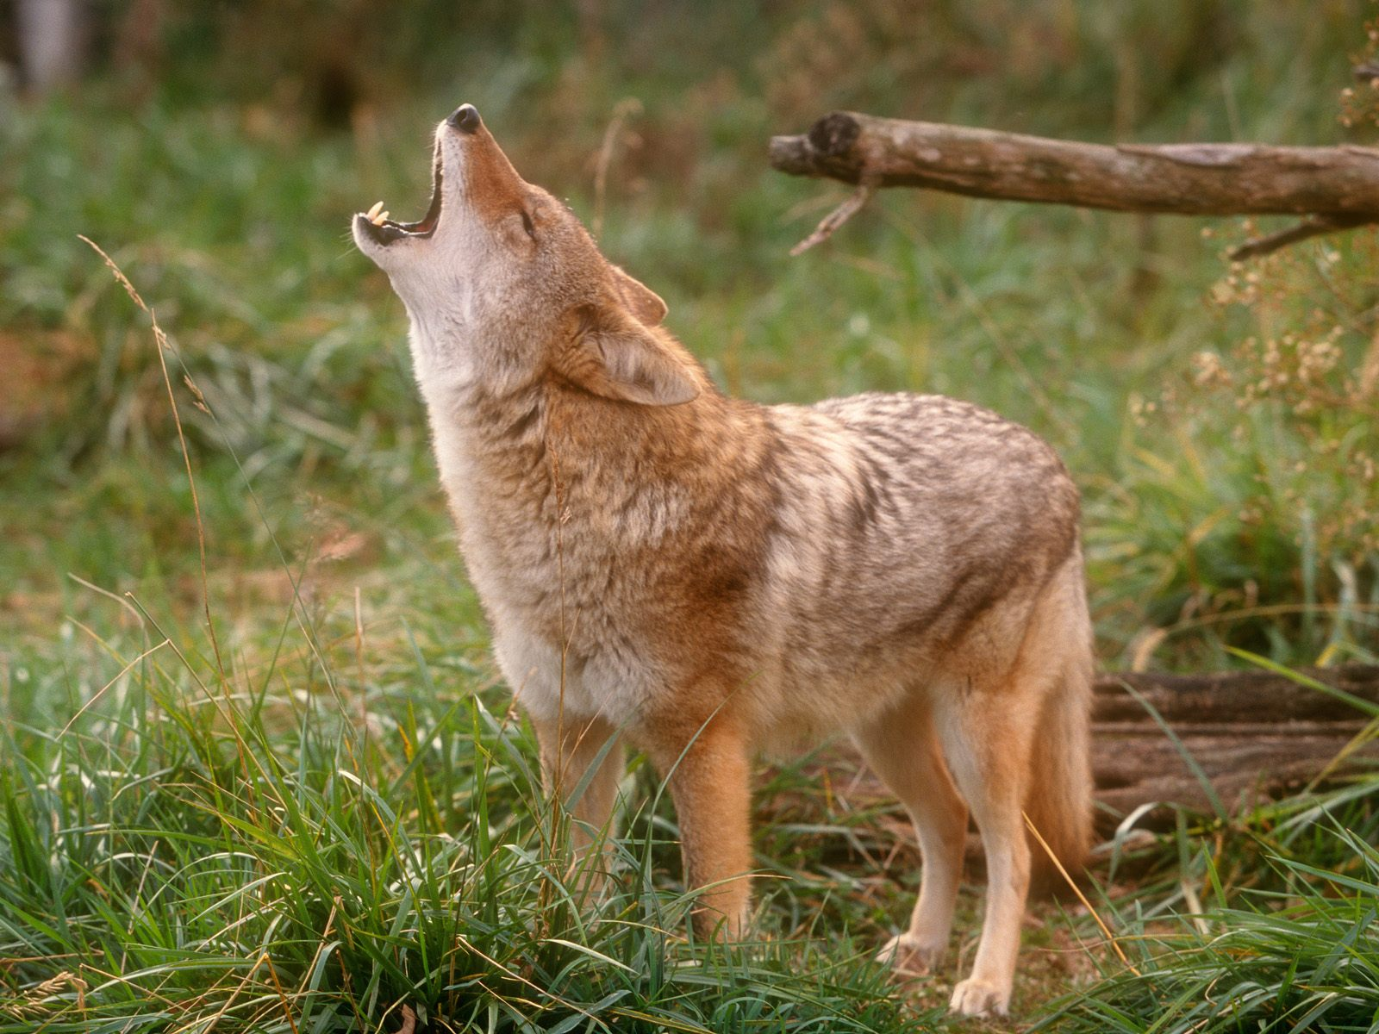
these films are both CONSERVATIVE AND PROGRESSIVE
  they mourn the passing of an older, rougher, simpler society just as they acknowledge the inevitability of a new society

Slide 12
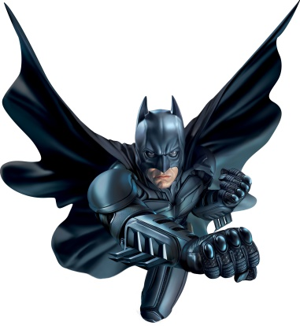
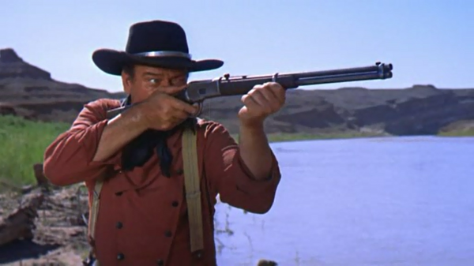
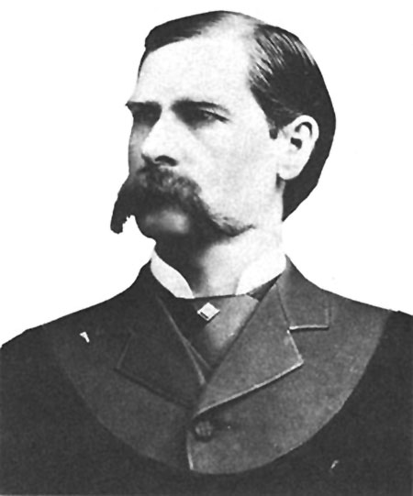
THE ANTI-HERO
Flawed, lead character, often dissolution with society and is more accessible to viewers.
Could be a noble criminal or vigilante
Rejection of traditional American values
  Examples in this unit: Ethan Edwards, Wyatt Earp, Doc Holiday
  Outside this unit: Basically any Clint Eastwood Western Character, Batman, Jason Bourne, etc…

Slide 13
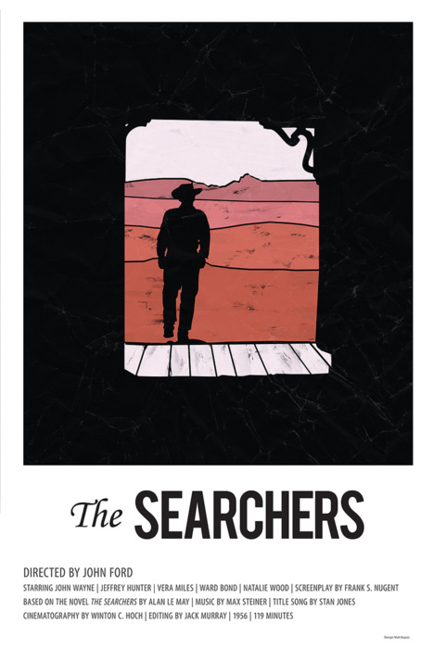
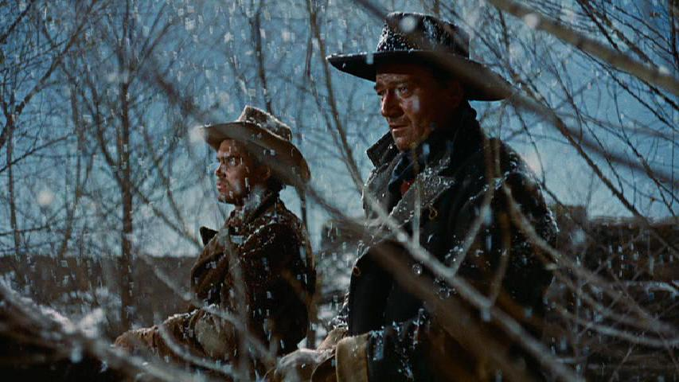
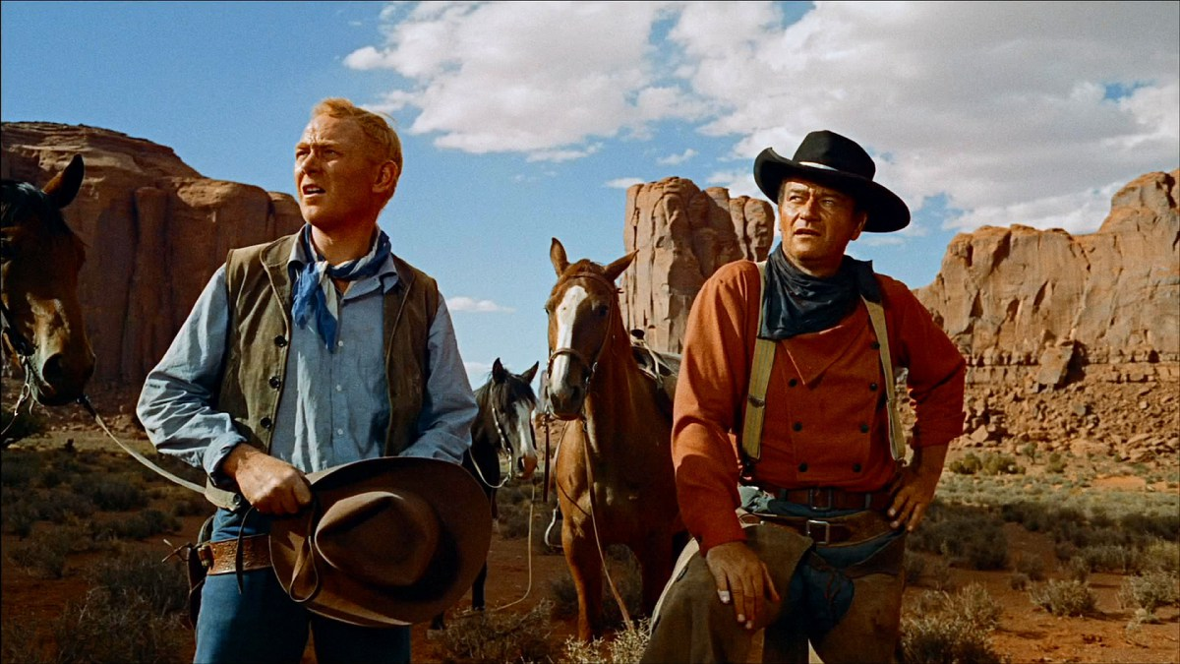
The Searchers
1956, Technicolor Film
Director: John Ford (The Informer, Grapes of Wrath, The Man Who Shot Liberty Valance, The Quiet Man)
Screenplay: Frank S. Nugent
Although this film did not receive any Academy Award nominations, it was named by the AFI as the greatest Western Film of all time and is #12 of the 100 Greatest American Moves of All time. In 1989, the Library of Congress selected this film for preservation in the National Film Registry
Main theme: Civil War veteran spends years searching for a young niece captured by Indians.
Genre: Western

Slide 14
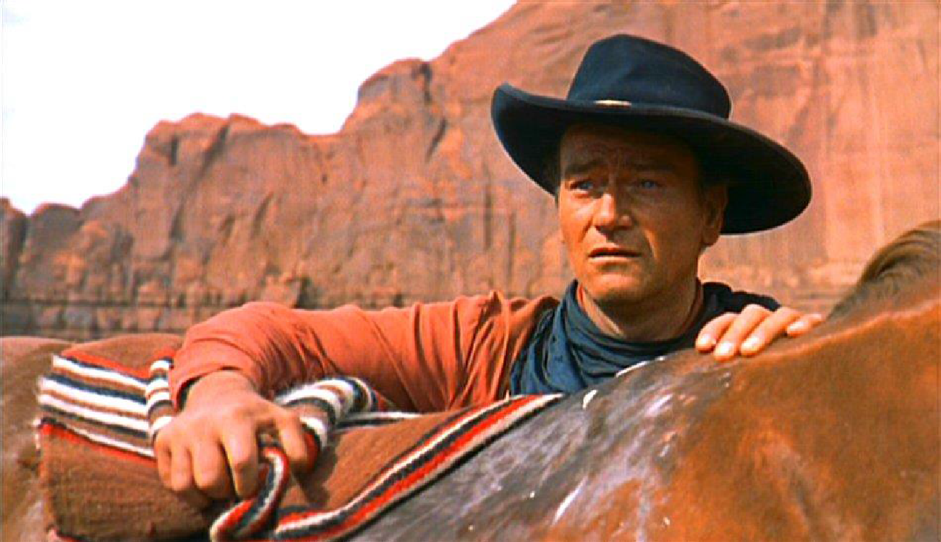
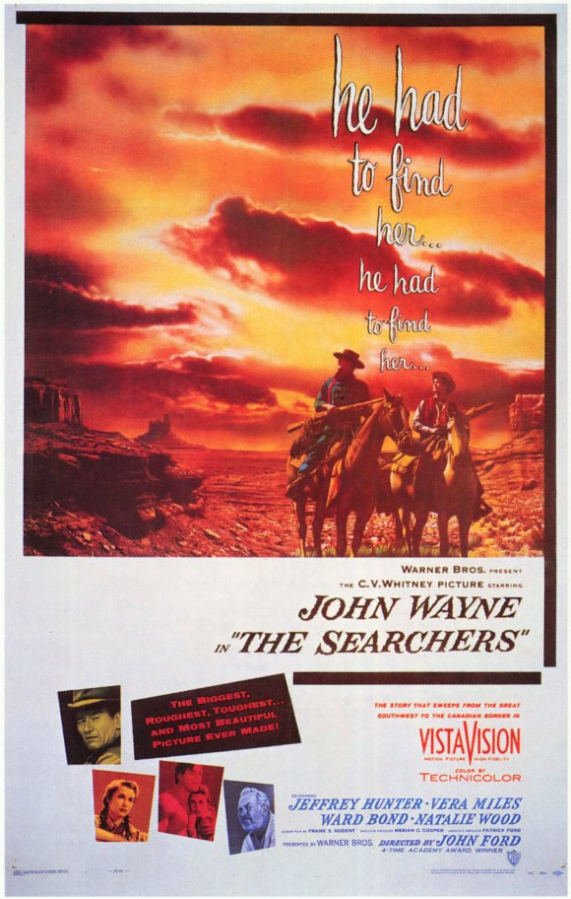
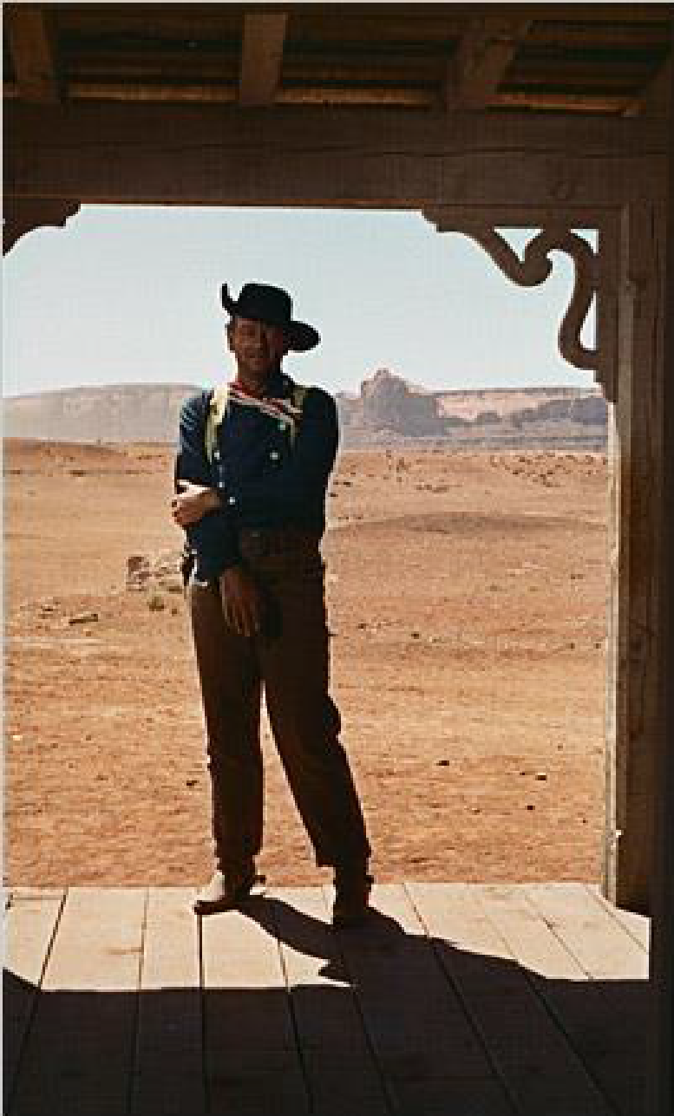
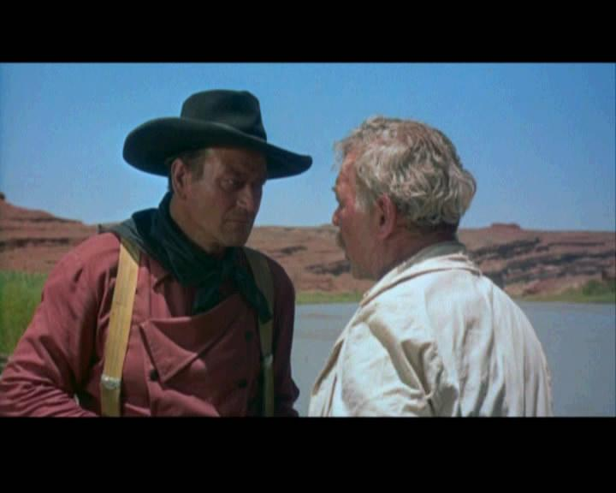
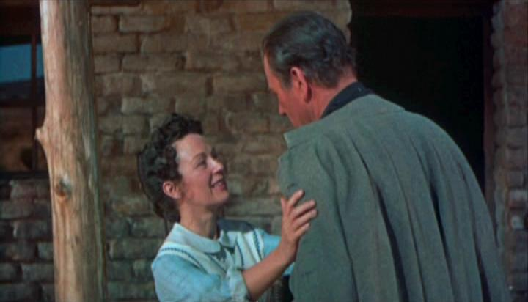

Slide 15
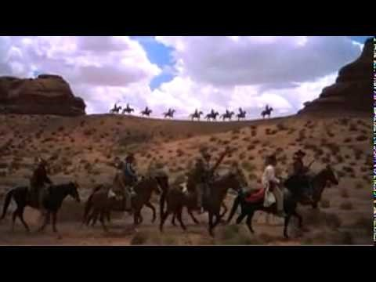

Slide 16
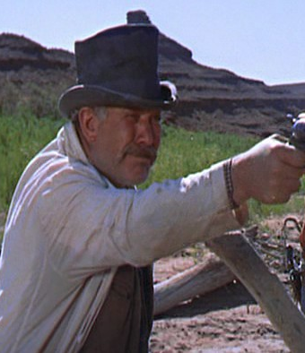
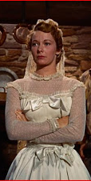
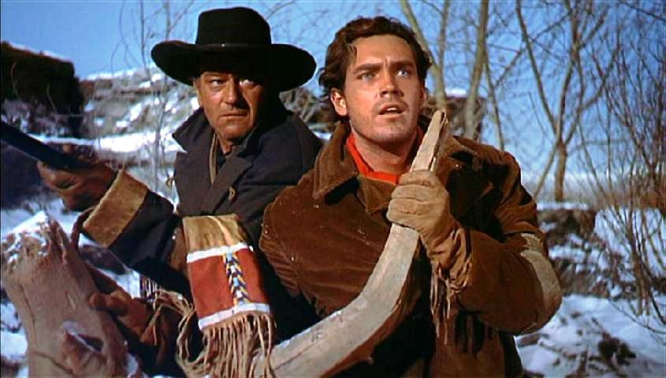
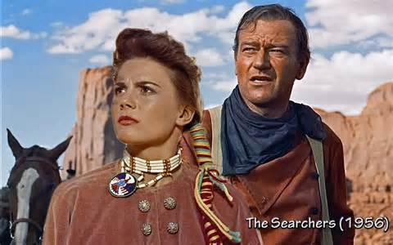
The Cast
Cast: John Wayne- Ethan Edwards
Jeffery Hunter- Martin Pawley, adopted son of Edwards
Vera Miles- Laurie Jorgenson, love interest of Martin
Ward Bond- Samuel Clayton
Debbie Edwards (older)- Natalie Wood
Main theme: Civil War veteran spends years searching for a young niece captured by Indians.

Slide 17
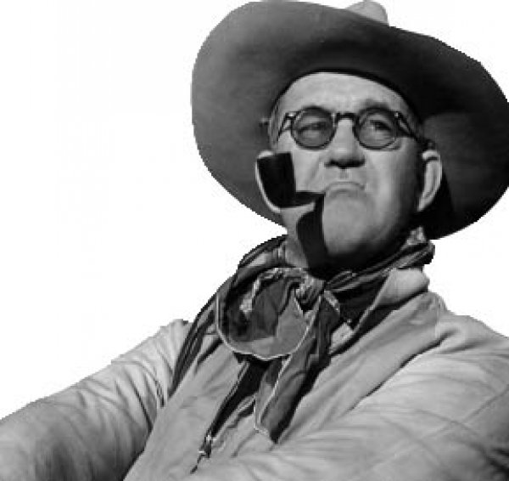
A Note about the director… John Ford
John Ford directed films from the era of silent films, through the war years and into the technicolor films of the 1950’s and 1960’s.
Ford is famous for what is called “The Long Shot”
Served as inspiration to some of the most admired film makers of the modern era
  Frank Capra, Alfred Hitchcock, Elia Kazan
  Martin Scorsese, Steven Spielberg, Orson Wells
  David Lean (Inspired Lawrence of Arabia)
  George Lucas (Inspired Star Wars)
  Star Wars(Luke’s search for Leia) & the scene where Luke sees the destruction of his home on Tatooine
  Breaking Bad creator Vince Gilligan said that The Searches influenced the final episode of the show entitled “Felina”

Slide 18
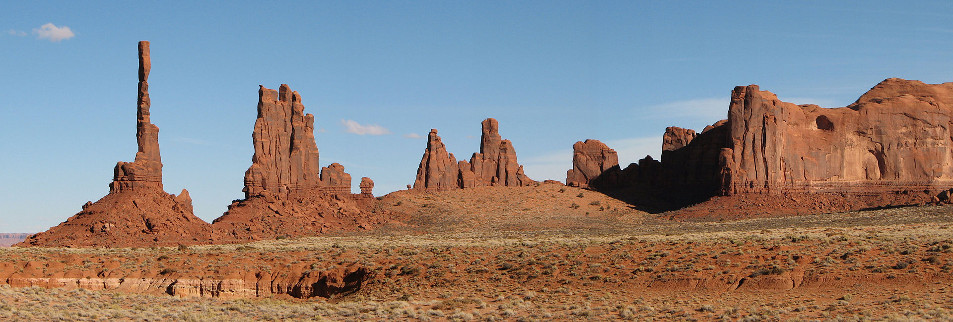
The Long Shot
Monument Valley, UT

Slide 19
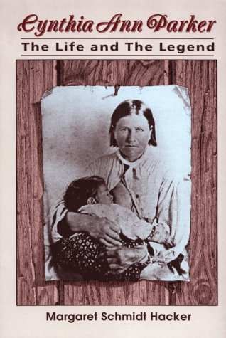
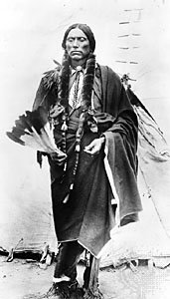
Based on real events…maybe
The 1836 kidnapping of nine-year-old Cynthia Ann Parker by Comanche warriors who raided her family's home at Fort Parker, Texas inspired the film, The Searchers. She spent 24 years with the Comanche, married a leader and had children, only to be rescued against her will by Texas Ranger, James W. Parker, her uncle.
Quanah Parker, Son of Cynthia Ann Parker

Slide 20

Who were the Comanche?
Native Americans most notable in the Southwest, (Texas, Colorado, New Mexico)
Famous for Horse Culture
Trade with Spanish, Mexicans, other natives (Shoshone) and eventually the USA.
Were known for kidnapping for ransom

Slide 21
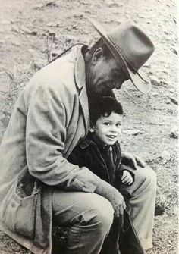
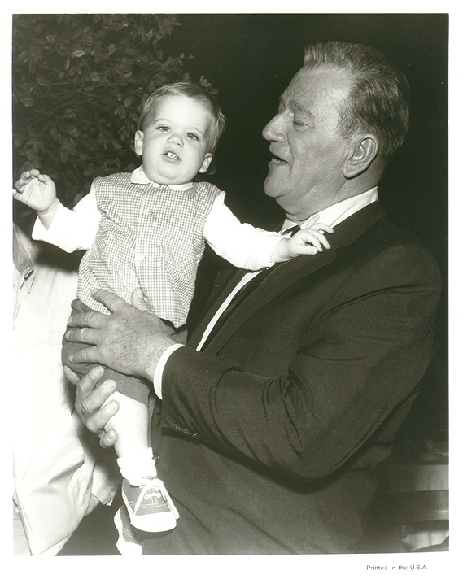
Fun Trivia
Considering the part of Ethan Edwards to be the best character he ever portrayed on-screen & his favorite film role, John Wayne named a son Ethan in homage.
The eccentric character of Mose Harper is loosely based on an actual historical personage called Mad Mose, a legendary half-crazy Indian fighter of the American southwest with a fondness for rocking chairs.
Buddy Holly's famous song "That'll Be the Day" was inspired by John Wayne's frequent use of the phrase in this film

Slide 22
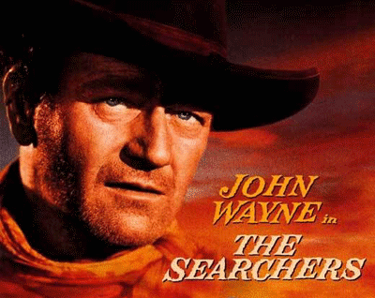
Case study of Ethan Edwards
Ethan’s obsessiveness, his absolute hatred of Comanches and all Native Americans and his loneliness set him apart from any other characters Wayne played and, really, from most protagonists in American movies.
He hates Comanches so much that he actually has bothered to learn their beliefs in order to violate them.
When Ethan finally finds Little Debbie, she's taken on the ways and language of her captors, he's suddenly ready to kill her…murderous fixation and disgust are side by side.
The mystery of Ethan’s life searching for someone, realizes his goal, brings her back and then walks away. Ethan's sense of purpose has been fulfilled, and like the man whose eyes he's shot out, he's destined to wander forever between the winds.

Slide 23
What else is going on in America that might have influenced the making of this film?
Civil Rights Movement
  1954 Brown v. Board of Education outlawing segregation in schools.
  Rosa Park’s refusal to sit in the back of the bus.
  Montgomery Bus Boycott.

Slide 24
Does Ethan really hate Martin?
He will not let him see the bodies of’ the family or, later, of Lucy in the ravine.
He does not tell him until later that the scalp on Scar’s lance is that of Martin’s mother.
He makes him the beneficiary of his will.
He trusts him to be the one to try and rescue Debbie before the cavalry attacks the village.

Slide 25
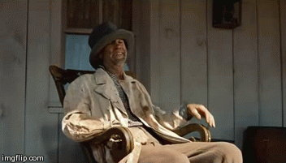
Theme: Change
The Mexicans are trading with the Native Americans.
The Army are using Mexicans and Indians as guides.
Mrs. Jorgenssen gives an impassioned speech about the future.
Marty is himself a product of inter-marriage.
Look’s tribe represents the new Native Americans, whilst the Jorgenssens represent the immigrant farmers.
Cavalry are represented in a very negative way. They needlessly kill Look and then in the final attack their officer is portrayed as immature and inexperienced.

Slide 26
Revenge as a motive
Was it really about the niece or the entire family?
A major theme of the film is the historical attitude of white settlers toward Native Americans.
Ford was not the first to attempt this examination cinematically, but his harsh depiction was startling, particularly to later generations of viewers.

Slide 27
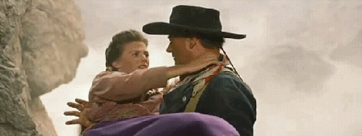
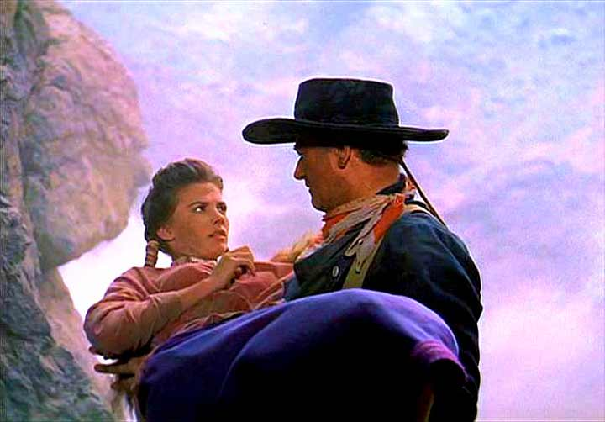
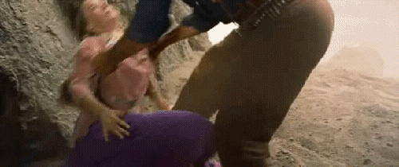
Ethan and Debbie
Edwards, fierce, alone, a defeated soldier with no role in peacetime
Ethan's redemption is intended to be shown in that dramatic shot of reunion with Debbie, where he takes her in his broad hands, lifts her up to the sky, drops her down into his arms, and says, “Let's go home, Debbie.”
When confronted with his own love for the girl, and all this means - his love for her mother, his own tender feelings of years ago - it simply is stronger than this hate that he has felt for years

Slide 28
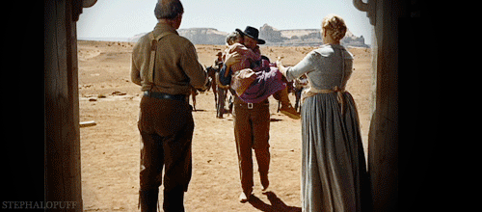

Slide 29
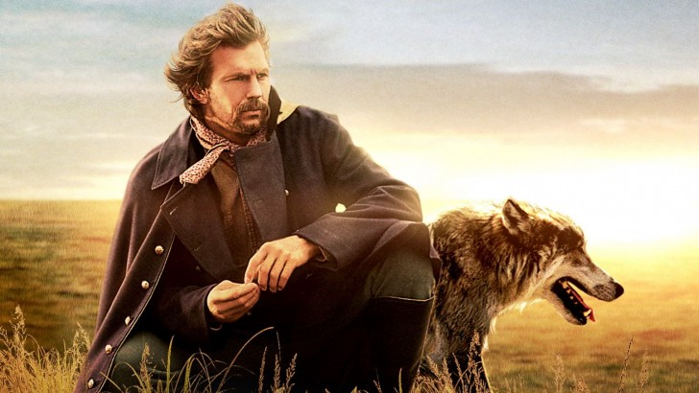

Slide 30
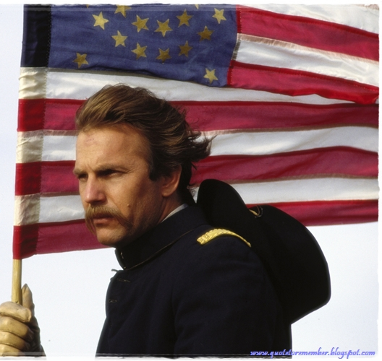
DANCES WITH WOLVES
Directed by Kevin Costner (1st Film)
Novel and Screenplay by Michael Blake
Winner of Seven Academy awards including Best Picture, Best Director, Cinematography, Adapted Screenplay
It is credited for revitalizing the Western Genre of filmmaking and like The Searchers is preserved by the Library of Congress
Budget of 15-22 million with returns of 424 million

Slide 31


Slide 32
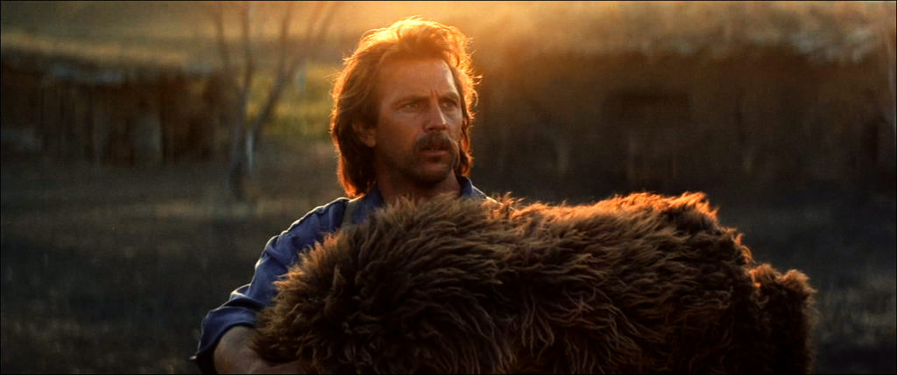
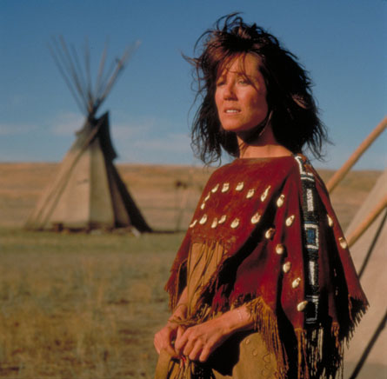
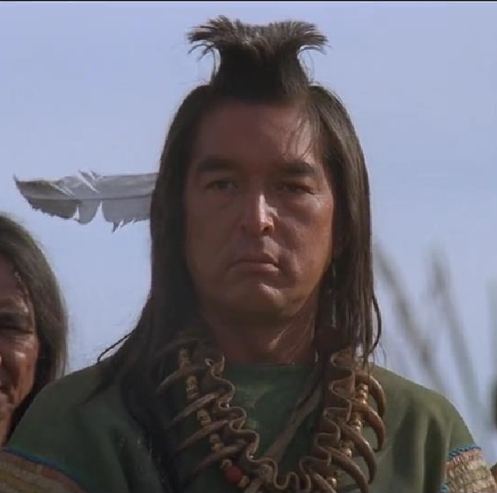
THE CAST
Kevin Costner- Lt. Dunbar/Dances with Wolves
Mary McDonnell- Stands with a Fist
Graham Greene- Kicking Bird
Wes Studi as Toughest Pawnee

Slide 33
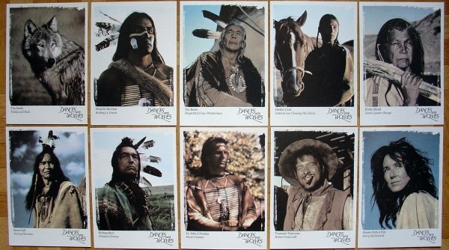

Slide 34
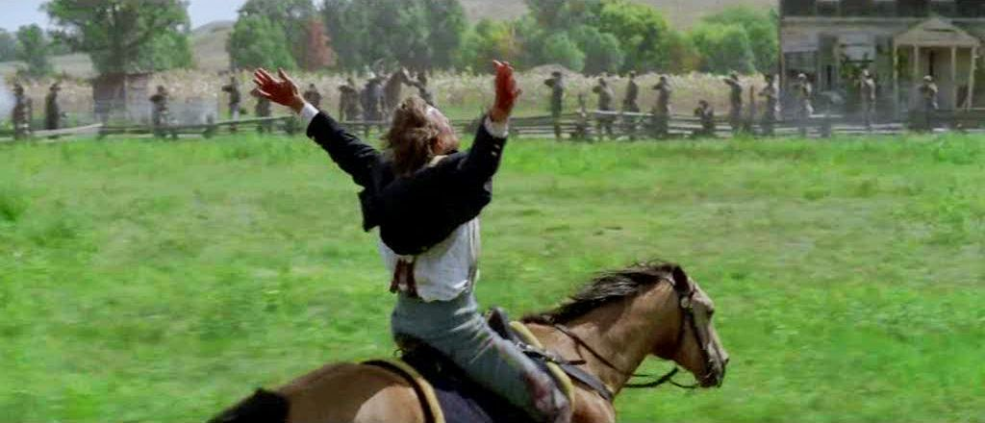
THIS IS THE PART I CUT OUT….HE TRIED TO GET SHOT BY THE CSA

Slide 35
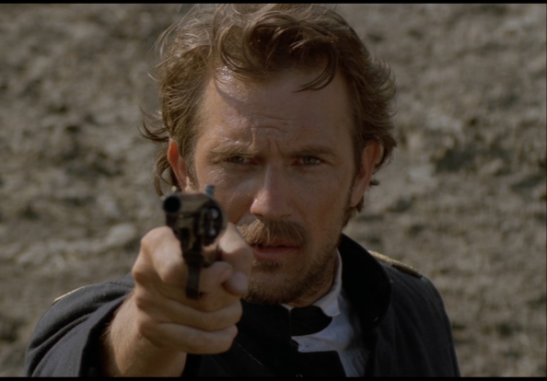
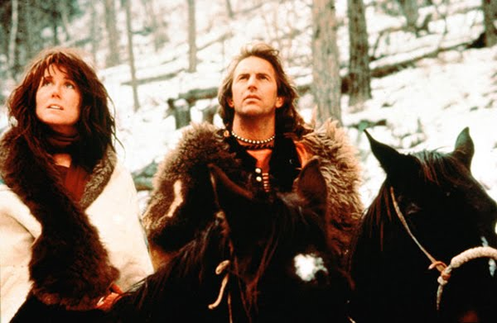
From John Dunbar to Dances with Wolves
Dunbar felt suicidal as a Union officer but has been replaced by utter clarity as Dances with Wolves: He knows why he was fighting, and he knows why he was willing to risk losing his life.

Slide 36
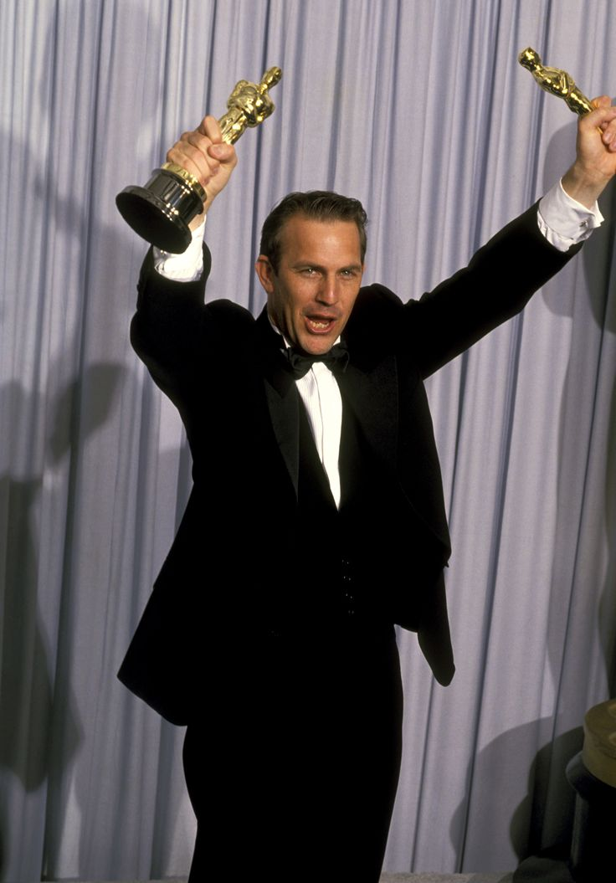
Criticisms of Dances with Wolves
Dances With Wolves is a “what if movie” that imagines a world in which whites were genuinely interested in learning about a Native American culture that lived more closely in harmony with the natural world than any other before or since.
Additionally, some criticism Dances with Wolves as a "white savior" film, as Dunbar attempts to save the Native Americans.
  Similar to the criticism in Glory about Col. Shaw
Use of the "noble savage" Native American type.
  Similar to The Last of the Mohicans

Slide 37


WHAT ABOUT THE BUFFALO?
Some little known buffalo facts: 3500 were used in the production, with two of the tamed ones belonging to rocker Neil Young.
How did they get a buffalo to charge on film? Tempt the buffalo with Oreo cookies.

Slide 38



TWO SOCKS
I don’t really know what to say about Two Socks, I just felt something needed to be said.
RIP Two Socks
Huey Long Feazel has two brown feet, does that count?

Slide 39

STANDS WITH A FIST
Based on the story of Cynthia Ann Parker…sound familiar
  think little Debbie from The Searchers
Serves as translator for Sioux and Dunbar.
She later becomes his wife.
Actress Mary McDonnell was nominated for an Academy Award

Slide 40


Slide 41

Bury My Heart at Wounded Knee
Based on the book by Dee Brown
Film written by Daniel Giat
Directed by Yves Simoneau
  Assassin’s Creed, Nurenberg
Distributed by HBO
Produced in conjunction with Dick Wolf (Law and Order)
17 Emmy Awards and wins 6 including Outstanding Made for TV Movie, Cinematography, etc…
3 Golden Globe Nominations for Best Miniseries and Best Actor/Actress

Slide 42



The Cast
Adam Beach as Charles Eastman
Anna Paquin as Elaine Goodale
August Schellenberg as Sitting Bull
Adian Quinn as Senator Henry L. Dawes
Wes Studi as Wovoka

Slide 43

The Real Charles Eastman
Lakota Sioux
  Ohiyesa (Oh ee suh) - the Winner.
Educated at Dartmouth College
Medical School in Boston
Married Elaine Goodele after the Wounded Knee Massacre
Moved to start a medical practice in 1893 with his wife and child.
International Committee of the YMCA, where he spent the next 3 years traveling throughout the US and Canada visiting many Indian tribes in an attempt to start new YMCAs in those areas.
In 1897, Dr. Eastman went to Washington as the legal representative and lobbyist for the Sioux tribe.
From 1899 to 1902, he again served as a government physician to the Sioux, this time at Crow Creek Agency in South Dakota.
Prolific writer about the Sioux

Slide 44

Elaine Goodele Eastman
From a prominent New England Family that lost its money in the Panic of 1873
Poet and writer, sympathetic to Native American culture
Married Charles Eastman
Edited his books while married

Slide 45

Why can’t people prosper on 160 acres of land?
Most farmers produced primarily for the cash market and adapted their crops.
Wheat farmers, in particular, prospered.
Startup costs for a farm could keep a family in debt for decades.
  The large capitalized farmer had the advantage over the small one.

Slide 46
Photos of Wounded Knee 1890 -1973
http://blogs.denverpost.com/captured/2014/01/02/wounded-knee-1890-1973-photos/6496

Slide 47


Chief Red Cloud and Sitting Bull

Slide 48

Wounded Knee 1890 in Photos
Miniconjou chief Spotted Elk (aka. Bigfoot) lies dead in the snow after massacre at Wounded Knee. Trager and Kuhn, photographer/Northwestern Photo Co., Chadron, Nebraska.

Slide 49


Slide 50

"Burial of the dead at the battle of Wounded Knee, S.D." U.S. Soldiers putting Indians in common grave; some corpses are frozen in different positions. South Dakota. c1891

Slide 51
Dawes Plan Results for the Lakota Sioux
Native Americans lost about 90 million acres (360,000 km²) of treaty land, or about two-thirds of their 1887 land base.
About 90,000 Indians were made landless.
Dawes Act disrupted Native American tribes' communal life and culture

Slide 52
Medal of Honor Controversy
20 soldiers from the 7th Calvary received Medals of Honor for their service to the US Government at the Battle of Wounded Knee
In 2001, National Congress of American Indians passed resolutions to condemn the Medals of Honor and asked the US Government to resend them.
No action has been taken

Slide 53

Tombstone

Slide 54

TOMBSTONE
Directed by George P. Cosmatos
  Directed Rambo II
Written by Kevin Jarre
  Wrote Glory
25 million in budget and earned 56 million
Does not win any major acting awards but does continue the Western Genre rebirth started by Dances with Wolves
Critics and movie goers alike praise Val Kilmer’s performance as Doc Holiday.
Competes against Kevin Costner’s Wyatt Earp which was released 6 months later and lost 40 million

Slide 55

THE CAST
Kurt Russell as Wyatt Earp
Val Kilmer as Doc Holiday
Bill Paxon and Morgan Earp
Sam Elliott as Virgil Earp

Slide 56





Allen Street

Slide 57

Tombstone
In 20 years it is estimated that the area yielded some $40m in silver and $3m in gold.
The mines were abandoned at the beginning of the 20th century and Tombstone became a ghost town

Slide 58




Slide 59


Wyatt Earp
Earp moved from town to town across the West, earning his living as a saloonkeeper, gunslinger, gambler, miner and frontier lawman, alongside his brothers. Late in life, he settled in California, and collaborated on a largely fictionalized account of his life that made him a popular hero when it was published in 1931, two years after he died.

Slide 60
Wyatt Earp, post Tombstone
Earp, who had no children, was the last surviving participant of the OK Corral gunfight.
consulted on Hollywood westerns and gotten to known various actors and directors.
His funeral was attended by such celebrities as Western film star Tom Mix, who served as a pallbearer.
After his death, Earp was portrayed by Hollywood as a heroic lawman, thanks in part to a best-selling—but significantly embellished—1931 biography, “Wyatt Earp: Frontier Marshall” by Stuart Lake.

Slide 61

Dodge City Peace Commission
in Dodge City, Kansas, a booming center of the cattle trade; it was dubbed the “Wickedest Little City in the West.” For the next several years, Earp worked as a lawman in Dodge during cattle-trading season, spending the rest of the year as a professional gambler in Texas and New Mexico.
From left to right, standing: W.H. Harris, Luke Short, Bat Masterson, W.F. Petillon. Seated: Charlie Bassett, Wyatt Earp, Frank McLain and Neal Brown

Slide 62
What happened in tombstone?
In 1879, Earp and his longtime companion, Mattie Blaylock, left Dodge City for Tombstone.
Virgil was working as the town marshal, and Wyatt began working alongside him.
In March 1881, while pursuing a group of cowboys who had robbed a stagecoach, Wyatt struck a deal with local rancher Ike Clanton, who had ties to the cowboys.
Clanton soon turned against him, however, and began threatening the Earp brothers.
The feud escalated, and finally exploded into violence on October 26, 1881 at the O.K. Corral.

Slide 63


Slide 64
Virgil Earp
Virgil Earp served as the "Town Marshall", hired by the Southern Pacific RR, in Colton, California.
He lived without the use of his arm
died of pneumonia at age 62 in 1905
  still on the job as a peace officer.

Slide 65

Goofs from the Film
Virgil and Morgan Earp were not ambushed during the same evening.
Virgil was shot in December, 1881, Morgan was killed in March, 1882.

Slide 66



Doc Holliday
Grew up near Valdosta Georgia
Doc after his graduation of Dental School
Doc in the West
Big Nose Kate “Mary Catherine Haroney” a “soiled dove”
Tuberculosis is a bacterial disease usually affecting the lungs (pulmonary TB). Other parts of the body can also be affected, for example lymph nodes, kidneys, bones, joints, etc. (extrapulmonary TB).
Wyatt Earp was chasing a felon named Rudabaugh, came to Holliday for information. He and Wyatt would become friends.
Holliday became involved with only eight shootouts in his life, despite his reputation.

Slide 67

John Henry Holliday
I found him a loyal friend and good company. He was a dentist whom necessity had made a gambler; a gentleman whom disease had made a vagabond; a philosopher whom life had made a caustic wit; a long, lean blonde fellow nearly dead with consumption and at the same time the most skillful gambler and nerviest, speediest, deadliest man with a six-gun I ever knew."
  Wyatt Earp on Doc Holliday
I'm your huckleberry” is a way of saying that one is just the right person for a given job.

Slide 68



The Love Triangle of Tombstone
Wyatt Earp John Beham Josephine Marckus

Slide 69


Slide 70

Shootout at the OK Corral
October 26, 1881
Wyatt, Virgil and Morgan, along with friend Doc Holliday shot it out with the Clanton and McLaury Gang.
  Warren and James Earp are absent in this film, despite their presence in Tombstone
Billy Clanton, Tom McLaury and Frank McLaury lay dead.
Wyatt did not carry the Buntline Special Colt at the OK Corral.
  His preferred gun was a Smith & Wesson American .44, nickel plated and scroll engraved.
Doc Holliday did not leave the O.K. Corral gunfight unscathed. He received a minor glancing blow to the hip, possibly from Frank McLaury, towards the end of the skirmish.

Slide 71


Robert Findley McLaury
Thomas Clark McLaury
Killed by Doc Holliday at the Gunfight at the OK Corral

Slide 72


Slide 73


Slide 74


Slide 75
More Goofs
Fred White did not die the night he was shot.
In fact, it was his testimony that the shooting was accidental that led to the freeing of "Curly" Bill, not a "lack of witnesses" as shown in the film.
He died two days after he was shot.

Slide 76
The Last Charge of Wyatt Earp and his Immortals aka The Arizona war or the Cochise Co. War
Wyatt Earp, Warren Earp, Doc Holliday, Sherman McMasters, Turkey Creek Jack Johnson, Texas Jack Vermillion and Dan Tipton
really an example of the failure of law enforcement during the era
April 1882, the Earp posse had been riding for nearly three weeks.
It was clear that they were never going to meet in the country with Behan's posse,
it was not safe to go back to Tombstone.
went to Henry Hooker's Ranch in the Sierra Bonitas.

Slide 77

Look…the long shot

Slide 78

The Iron Springs Shootout
The Iron Springs shootout between Wyatt's posse and Curly Bill's gang is depicted as an ambush
met almost by accident; Earp and his men were looking for water and came across Bill and his men, who were camping in the area.

Slide 79




Johnny Ringo
John Peters Ringo
The death of Ringo is still unsolved
Some believed that he committed suicide
Others take the view of the movie that Doc Holliday did it
Single gunshot wound to the head
Buried on private property

Slide 80

Ringo did challenge Doc Holliday (one of the survivors of the O.K. Corral fight) to a shootout. Holliday declined and citizens disarmed both men.
Ringo was found dead in Turkey Creek Canyon outside of Tombstone. It looked as if Ringo had shot himself in the head and the official ruling was that he had committed suicide. Some believed, however, that he had been murdered either by his drinking friend Frank “Buckskin” Leslie or a young gambler named “Johnny-Behind-the-Deuce.”
Wyatt Earp later claimed that he had killed Ringo.

Slide 81
What did they really say in Latin?
Doc Holiday- When I drink, I speak the truth?
Johnny Ringo- Do what you do best?
DH- I don’t believe drinking is what I do best?
JR- Fools have to learn by experience
DH- It’s your funeral

Slide 82



Ike Clanton
Ike Clanton was caught cattle rustling in 1887, and shot dead by lawmen while resisting arrest.

Slide 83

What ever happened to doc holiday?
May 1887 Doc holiday went to Glenwood Springs, CO for health reasons. He lived at the TB sanitarium until he died.
Nov. 8 1887 Doc Holliday (age 36) died at Glenwood Springs, CO from tuberculosis and alcoholism. Doc Holliday did look older than his years due to his having TB and being a longtime alcoholic.
Doc Holliday's final resting place is an unmarked grave in the cemetery on a hill overlooking Glenwood Springs, CO in the mountain valley below.

Slide 84

What ever happed to Mattie Earp
Mattie Earp didn't die shortly after leaving Tombstone, but met up with Big Nose Kate and lived for another 8 years
On July 3, 1888, Mattie took a lethal dose of laudanum together with alcohol

Slide 85



The Final Resting Place

Slide 86


Slide 87
Discussion Questions
In your opinion, is Ethan Edwards in The Searchers a sympathetic character?
In what ways do Ethan’s and Scar’s personalities parallel each other?
When Ethan finally gets to Debbie, he doesn’t kill her but picks her up and says “Let’s go home, Debbie.” Does this reflect a change in Ethan’s attitude?
Ethan and Martin’s obsessive quest for Debbie cover a period of about five years. Have Ethan and Martin’s characters changed or matured throughout that time?
How do you interpret the final shot of The Searchers when Ethan stands outside the house, looking in through the doorway, then walks away?
Contrast Debbie from The Searchers and Stands with a Fist from Dances with Wolves by considering Pocahontas and Sacagawea as other archetypal images.
How and why does Dunbar “go native”? Compare and contrast Dunbar/Dances with Wolves with Nathaniel from Last of the Mohicans.
Why do you think draws Elaine Goodlele Eastman to the Sioux culture? Do you similar themes in Dunbar from Dances with Wolves. Compare Elaine and John Dunbar
Analyze the different cinematic views of Native Americans in The Searchers, Dances with Wolves and Bury My Heart at Wounded Knee
In what ways does the movie Tombstone fit your description of an adventure or morality tale?
How have we as a culture made heroes and villains out of the “real people” we viewed in this section of study? Charles Eastman, Senator Dawes, Sitting Bull, Red Cloud, Elaine Eastman, Cynthia Ann Parker, Doc Holliday, Wyatt Earp

Slide 88
Tombstone Assessment
Wyatt Earp, Virgil Earp, and Morgan Earp. Define their role and what happened to them.
Who was Doc Holliday before meeting Wyatt Earp? Why was he so loyal to Wyatt Earp?
Tombstone was known as a “boomtown”. What was a boomtown?
We saw a couple of times in the film a “private affair” turned violent… Did lawmen have authority over these situations? Why or why not?
In your opinion, how is justice depicted in this film? Do you agree or disagree with justice being enforced in this manner?
Who is your favorite character, and why is it Doc Holliday?

